Slide 1
Coupon Usage Prediction
And Machine Learning

Slide 2






What matter for a conversion?
Channel Source | Customer Behavior | Coupon information
AGE
Type of Business: beauty, massage, grocery, etc
City availability: Kansai, Kanto, Seul, etc
Number of different referrers
Number of Visits
Percentage of discount that is available: 0 – 100%

Slide 3
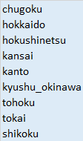
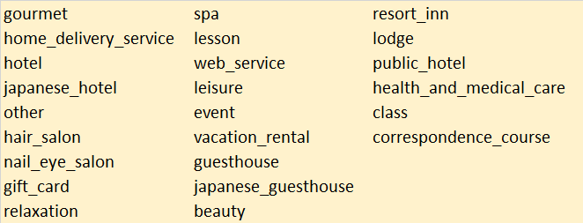
More details about the data

Slide 4
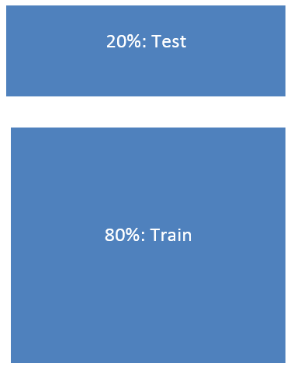
Experiment Stage 1: Data Partition
Cross Validation with Logistic Regression

Slide 5
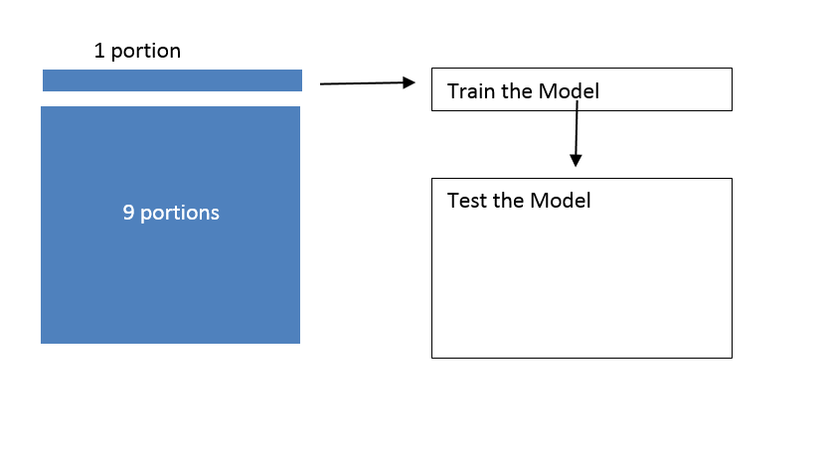
Experiment Stage 2: Cross Validation
Notes:
All the folds should have all the classes and linear combination of classes within the data

Slide 6
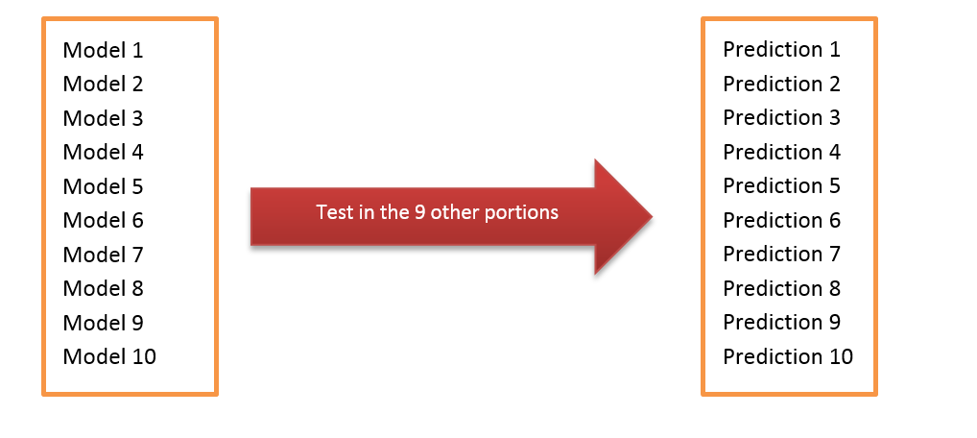
Experiment Stage 2: Cross Validation

Slide 7
Experiment Stage 3: Model Validation
Apply Model 5 to the test data, avoiding over fitting.

Slide 8
Logistic Regression Background
Y is a 1, 0 variable
X is any kind of variable, but if there’s factors it should be considered as a dummy variable.
Notes:
Our work here is to predict the betas based on the probability of purchase considering their behavior

Slide 9
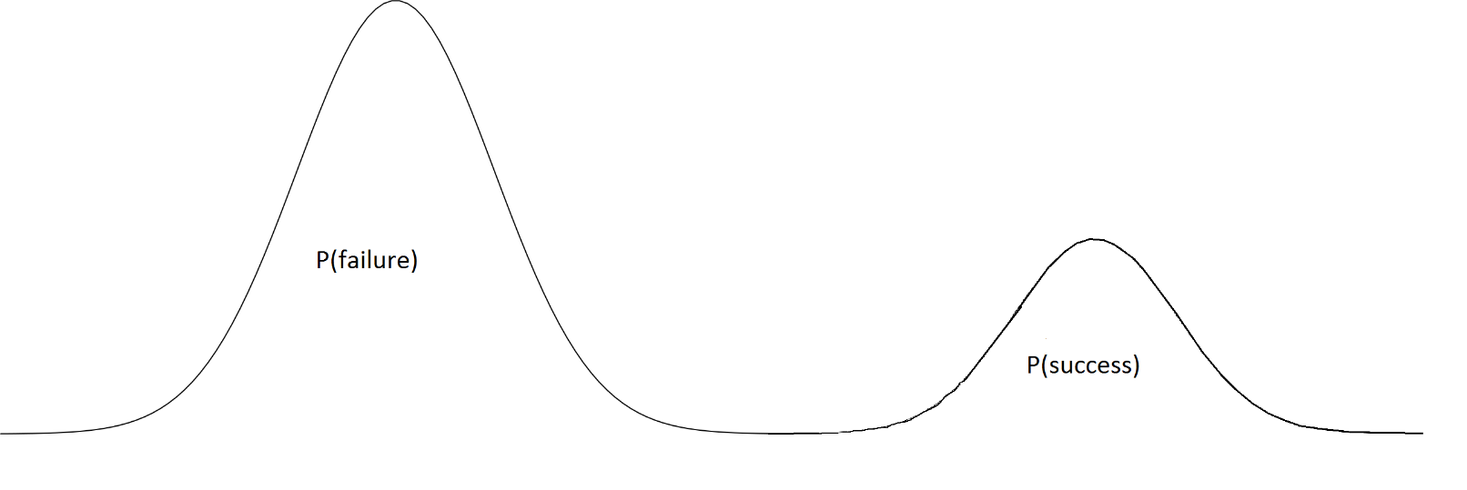
Problems with the model: evaluation
No intersection between success and failure.

Slide 10

Problems with the model: evaluation
In reality there’s intersection between them.

Slide 11
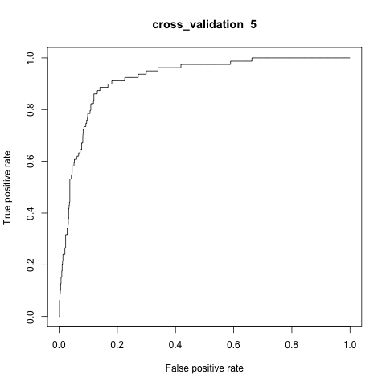
Because of that we use AUC as criteria
The interaction number 4 had the best performance.

Slide 12
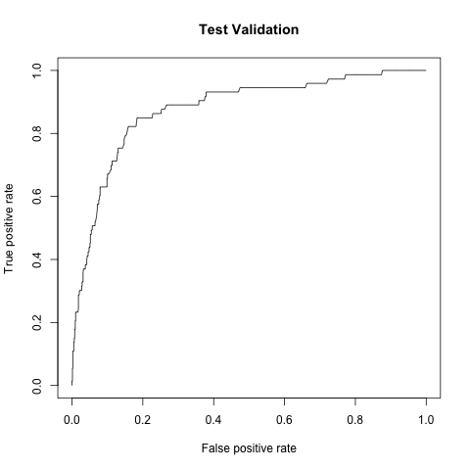
Test data Model Validation

Slide 13
Data test output
Not Significant to the Model | Positive significance to the Model | Negative significance to the model
Age | Price rate discount | Event business
Day of the week that is usable | #Unique referrer | Kansai, Kanto, Kyushu/Okinawa, Tokai
Some cities are not relevant Shikoku, Tohoku, Chugoku | # sessions
 | Female
 | # interactions in a single visit

Slide 14
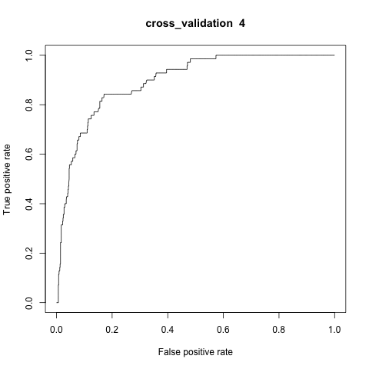
Features Selection

Slide 15
Data test output
Not Significant to the Model | Positive significance to the Model | Negative significance to the model
 | Price rate discount | Event business
 | #Unique referrer
 | # sessions
 | Female
 | # interactions in a single visit
Notes:
**Check the parameters

Slide 16

Then what?

Slide 17

Age? – Not relevant
Notes:
*variety of age

Slide 18

Days of the week – Not relevant

Slide 19

Diversity of channels: Yes

Slide 20
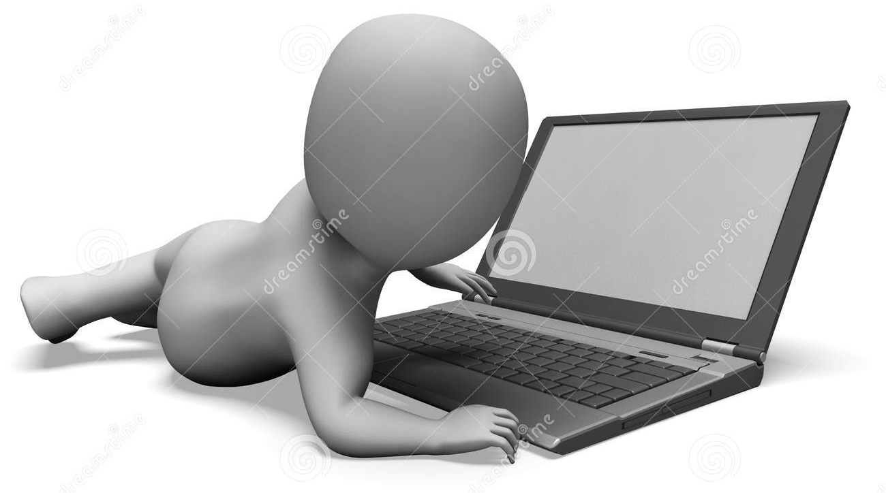
# of sessions: Yes

Slide 21
Female: Yes
Notes:
% of women

Slide 22
Low the likelihood of conversion
Coupons for event business.
If the coupon is to be used in any of this cities: Kansai, Kanto, Kyushu/Okinawa, Tokai

